Slide 1

Reflection and Transparency
CS 296
UNIVERSITY OF ILLINOIS AT URBANA-CHAMPAIGN
Eric Shaffer

Slide 2
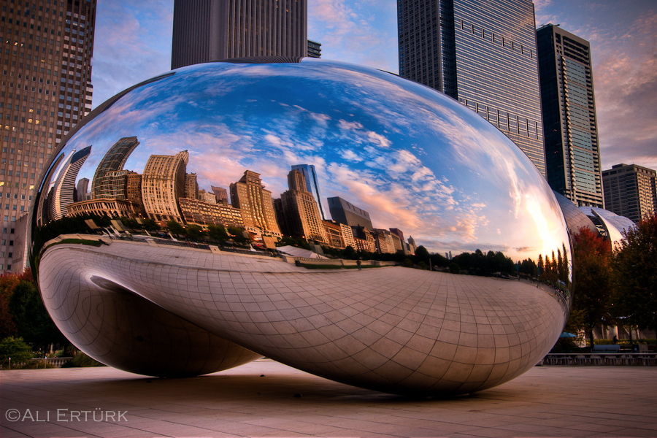
Objectives
Learn the core ideas behind the optics of mirrors
Understand how mirror reflection can be modeled in ray tracing
Be able to implement mirror reflection

Slide 3
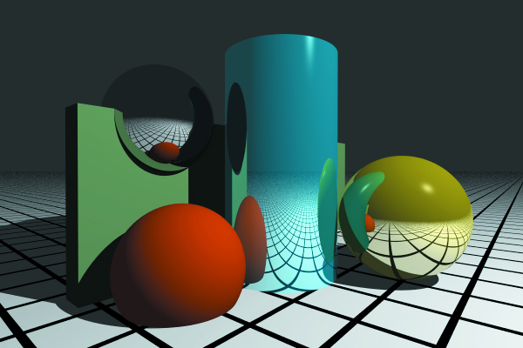
Reflection
Mirror reflection is an effect of indirect illumination
Up till now we have focused on direct illumination
Recursive ray-tracing technique first developed by Whitted (1980)
you will still sometimes see the term “Whitted-style ray-tracing” used
Goal: model specular-to-specular light transport with perfect reflection

Slide 4
Illumination Model
Indirect illumination can arrive from any direction
L_{r} is reflected light
L_{i} is incident radiance… ….obtained by shooting ray r_{c} into the hemisphere above p
We’ll only consider the light obtained in the mirror reflection direction

Slide 5
Perfect Mirror Reflection

Slide 6
Perfect Mirror Reflection
For mirror reflection, incident radiance comes from a single direction

Slide 7
Perfect Mirror Reflection
Note that there is no cosine term for mirror reflection
There is no scattering
So the cross-sectional area is unchanged by reflection

Slide 8
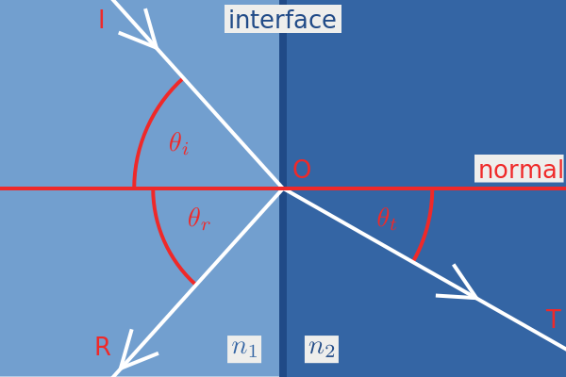
Mirror reflection BRDF
A physical approach for deriving a BRDF would use the Fresnel Equations
These describe the behavior of light moving between 2 different media
We’ll look at that later
For now we’ll just use a constant f_{r}=k_{r}c_{r} k is the reflection coefficient in [0,1] c is the reflection color more formally….you can define a function that is 0 whenever the light isn’t coming from the mirror reflection direction and is equal to k_{r}c_{r} when it is from that direction…

Slide 9
Multiple Reflections
Your reflection ray can
Hit nothing (returns background color)
Hit a light (returns emitted light)
Hit a non-reflective object at point p’
Need to compute and return direct illumination at p’
Hit a reflective object at p’
Compute direct illumination at p’ plus indirect, recurse into the scene…

Slide 10
Multiple Reflections
Hit a reflective object at p’
Compute direct illumination at p’
For area lights, this means Monte Carlo integration
Compute indirect illumination at p’ recursively
Need to use a recursion depth limit to stop at some point
Add the two together and return

Slide 11
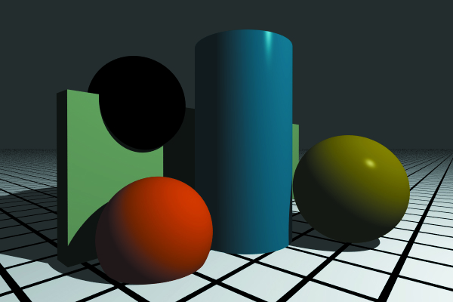
Examples
black sphere reflects no direct illumination
shows difference between recursion depth 0 and recursion depth 1

Slide 12
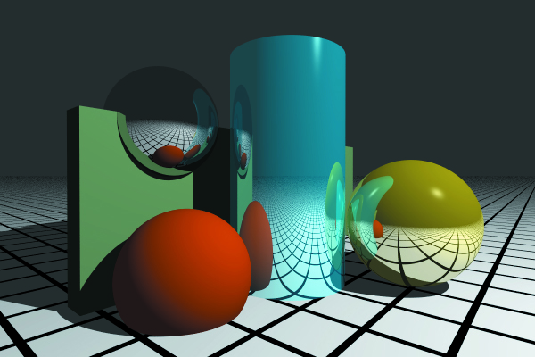
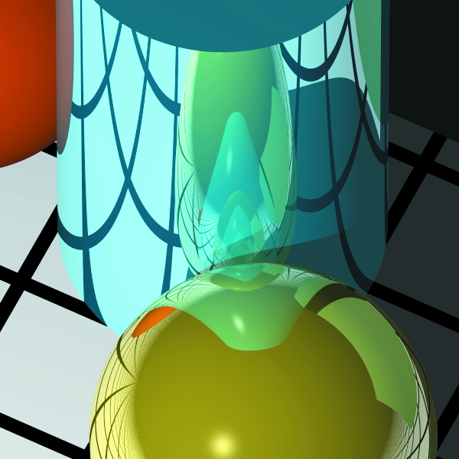
Examples
recursion depth = 10

Slide 13
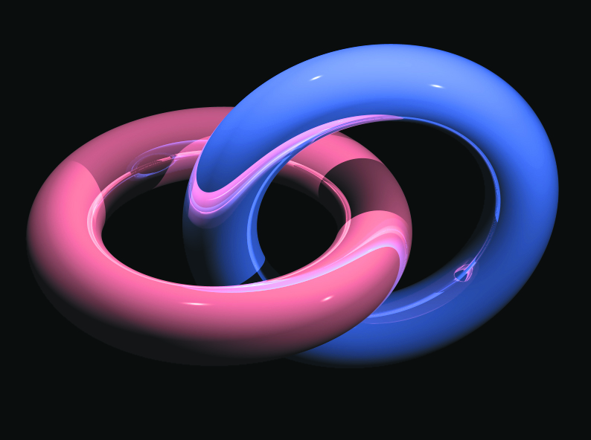
Self-Reflection

Slide 14
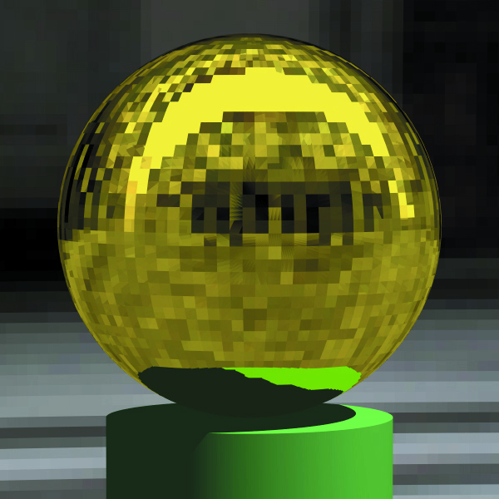
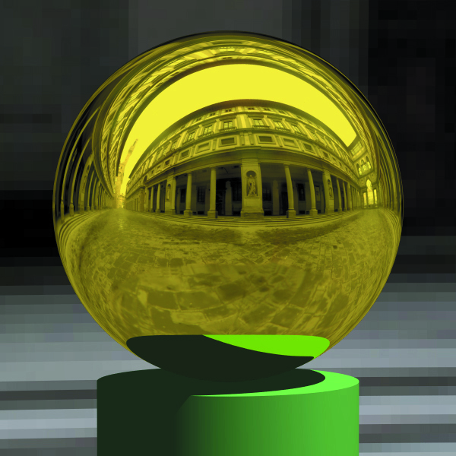
Reflective Meshes
Flat normals versus smooth change the appearance

Slide 15
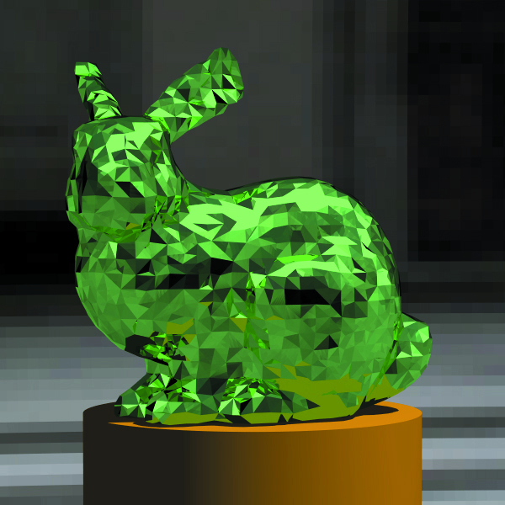
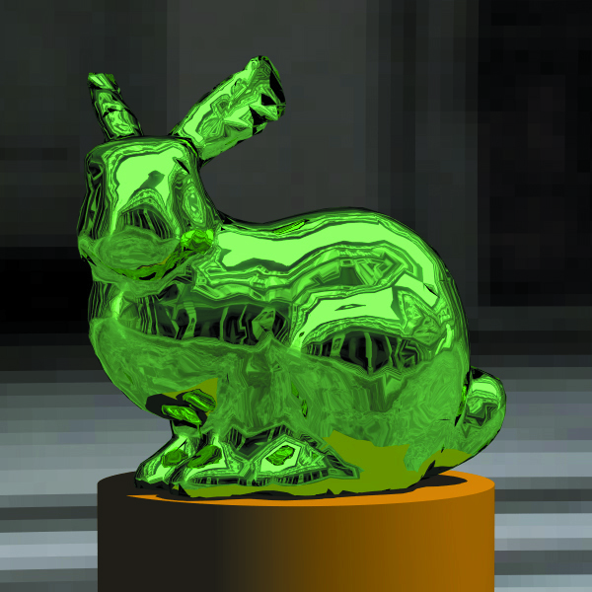
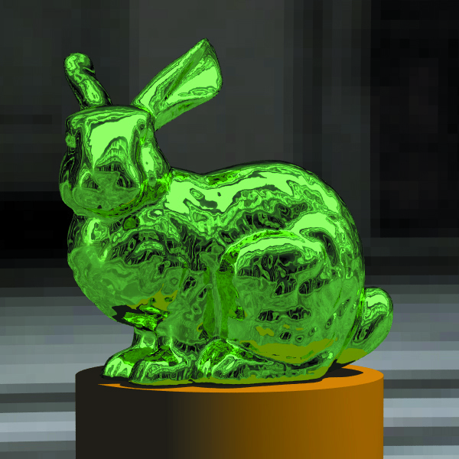
Reflective Meshes
Flat normals versus smooth change the appearance

Slide 16
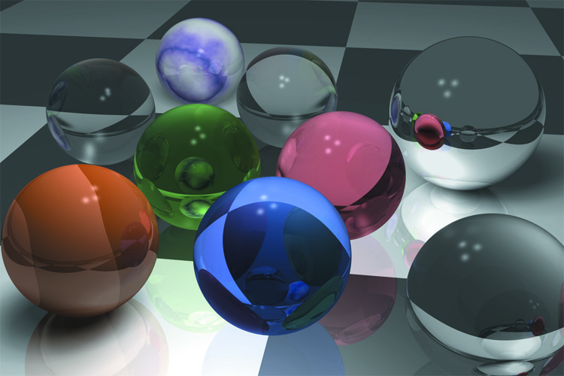
Transparency
Transparent media allow light to pass through them
Glass, clear plastic, air, water are all transparent media
A subset of materials know dielectrics which are also insulators
Any guesses as to how water can be on that list?

Slide 17
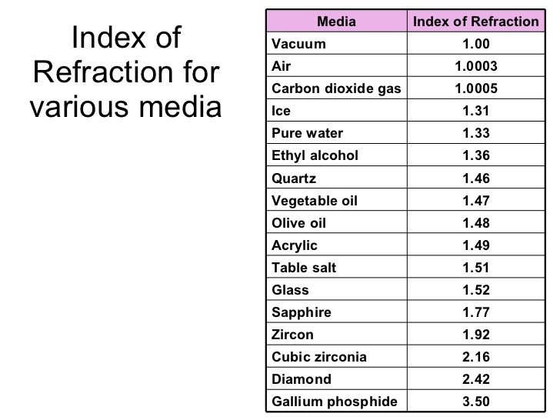

Index of Refraction
Speed of light is c = 2.99 x 10⁷ in a vacuum
Speed v is lower through a medium like air or glass
Absolute index of refraction $η=c/v$

Slide 18
Surface Physics
When a ray w_{o} hits the surface of a transparent medium
A reflection ray r is generated
A transmission ray t is generated
If the boundary is optically smooth
w_{o}, t, and r are in the plane of incidence
Transmission will be perfectly specular
Optically smooth → rough features much smaller than light λ

Slide 19
Surface Physics
Relative Index of Refraction is η=η_{in}/η_{out}
Need to find a direction for the ray t using Snell’s law

Slide 20
Surface Physics
t is bent away from ω_{o}
η_{out}<η_{in} it bends towards the normal
η_{out}>η_{in} it bends away from the normal

Slide 21
Total Internal Reflection

Slide 22
Total Internal Reflection
As the transmission direction approaches the surface
The energy in the transmission ray decreases
The energy in the reflection ray increases
When θ_{i} exceeds the critical angle
The transmission ray ceases to exist
All the energy is contained in the reflection ray
You can test for that condition

Slide 23
The Illumination Model
Illumination model is similar to that for reflection
But indirect component includes transmission plus reflection
Instead of a BRDF we have a BTDF
bidirectional transmission distribution function

Slide 24
The Illumination Model

Slide 25
The Illumination Model
Allow recursion level of at least 2
Why?
At each hit point, can generate 0, 1, or 2 rays
Can end up with large number of secondary rays
Long rendering times

Slide 26
The Illumination Model
Since we model perfect refraction
We do not need to compute an integral
Radiance changes as light crosses the boundary
k_{t} is the transmission coefficient [0,1]

Slide 27
The Illumination Model
Need to keep track of the direction of radiance transfer
Choose of refraction terms correctly
At point a radiance transfer is from inside to outside
At point b the transfer is from outside to inside

Slide 28
Practical Considerations
Total internal reflection can happen when a ray strikes a transparent surface from the inside or outside
When this happens, reflection coefficient should be set to 1.0
On a ray hit from inside an object, to compute t
reverse the normal direction
invert the relative index of refraction
change sign of cos θ_{i}

Slide 29
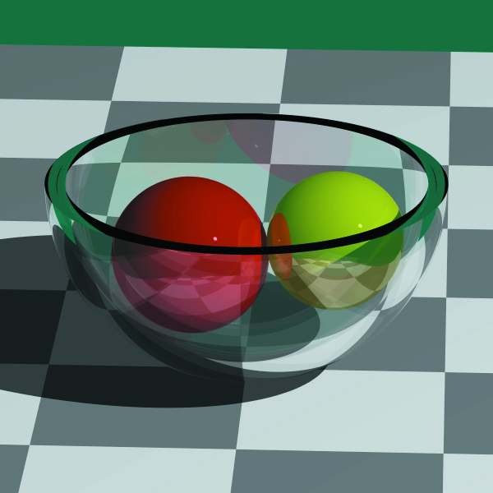
Example

